Slide 1
BRS
Book-Recommendation System
Group Members:-
Adwait Thangan
Swaraj Deshmukh
Arati Padwal
Sri Krishna
Alok
Umair

Slide 2







CONTENTS
What are recommender systems for?
Introduction
Model Deployment
Streamlit
Importing Dataset & EDA
Visualisation
Conclusion
Model Building
Model Evaluation & Testing
SVD Model
Testing the dataset

Slide 3
What are recommender systems for?

Slide 4

Why using Recommender Systems?
Value for the customer
Find things that are interesting
Narrow down the set of choices
Help me explore the space of options
Discover new things
Entertainment
Value for the provider
Additional and probably unique personalized service for the customer
Increase trust and customer loyalty
Increase sales, click trough rates, conversion etc.
Opportunities for promotion
Obtain more knowledge about customers
Book Recommendation System
A book recommendation system is a type of recommendation system where we have to recommend similar books to the reader based on his interest. The books recommendation system is used by online websites which provide ebooks like google play books, open library, good Read’s, etc.

Slide 5
Types of Recommender Systems?
Personal recommender systems
Collaborative recommender systems
Content-based recommender systems
Knowledge-based recommender systems
Hybrid recommender systems

Slide 6
Importing Dataset & EDA

Slide 7

Books Dataset
Contains Basic information regarding the books.
ISBN, Book-Title, Book-Author, Year of Publication, Publisher
All About the
Dataset
Users Dataset
Contains Basic information regarding the Readers.
UserID, Location, Age
Ratings dataset
Contains all of the user rating information
UserID, ISBN, Rating(1-10) 10 being the highest

Slide 8
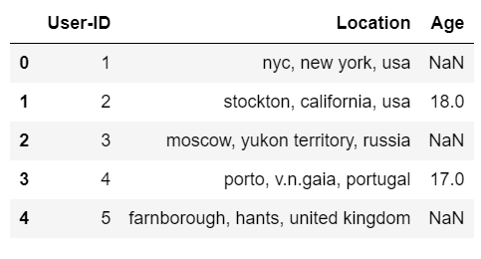
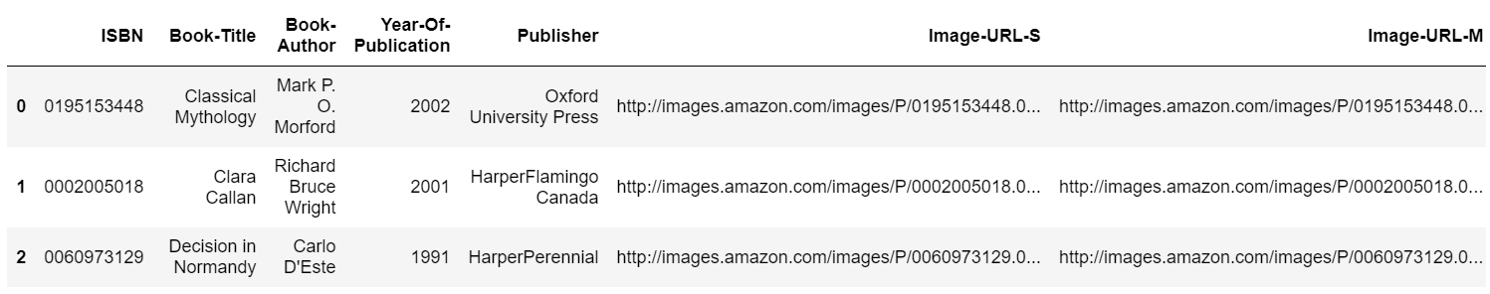
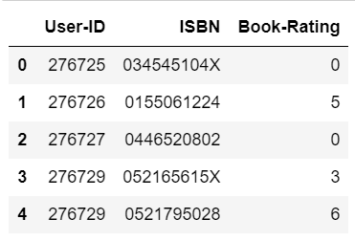
User Dataset
Book Dataset
Rating Dataset

Slide 9
Preparing Data (Data Clean-up)
Data was provided in 3 separate files.
Many null values in the Age column of users.
Data contained random errors. For example, some publisher name were entered into Year of Publication column and there were also Os entered for Year od Publication
location information was written as a long of strings. Was broken up into different columns containing City, State and Country information for cleaner analysis
Each file included lot of duplicated rows. All duplications were removed before stating

Slide 10
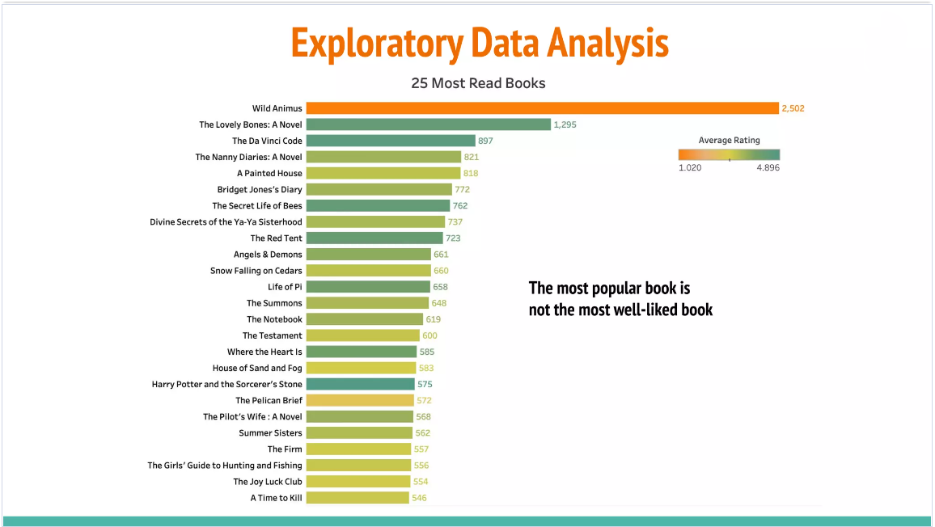

Slide 11
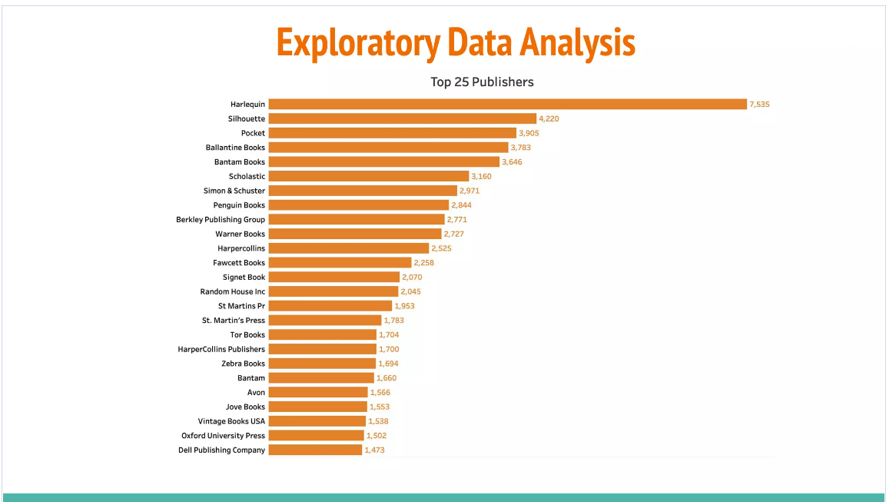

Slide 12
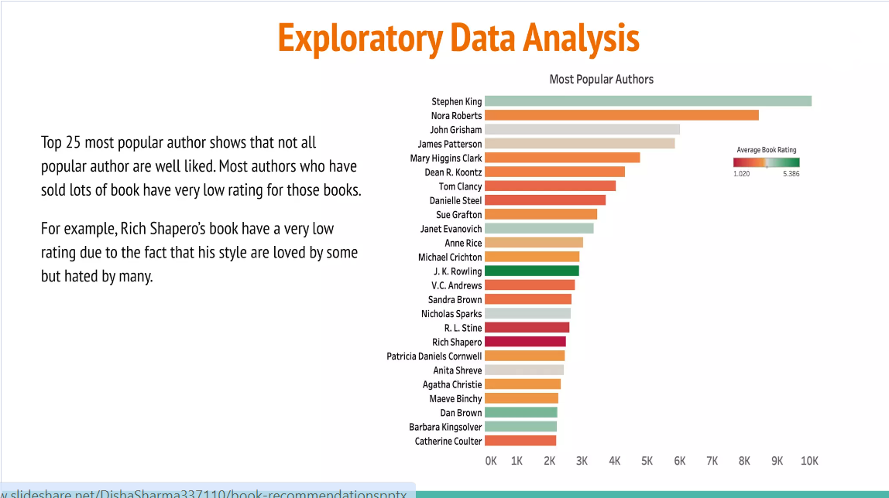

Slide 13
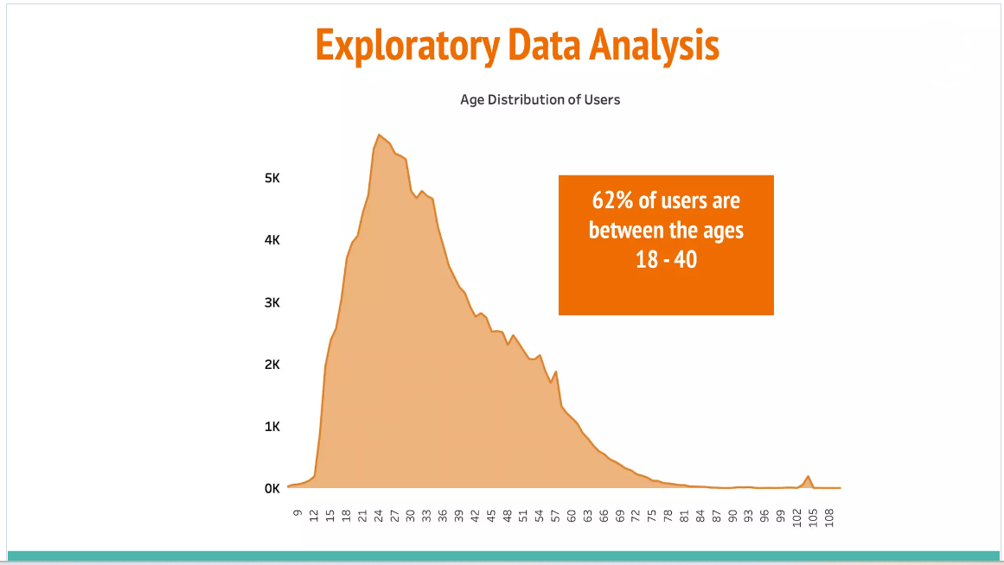

Slide 14
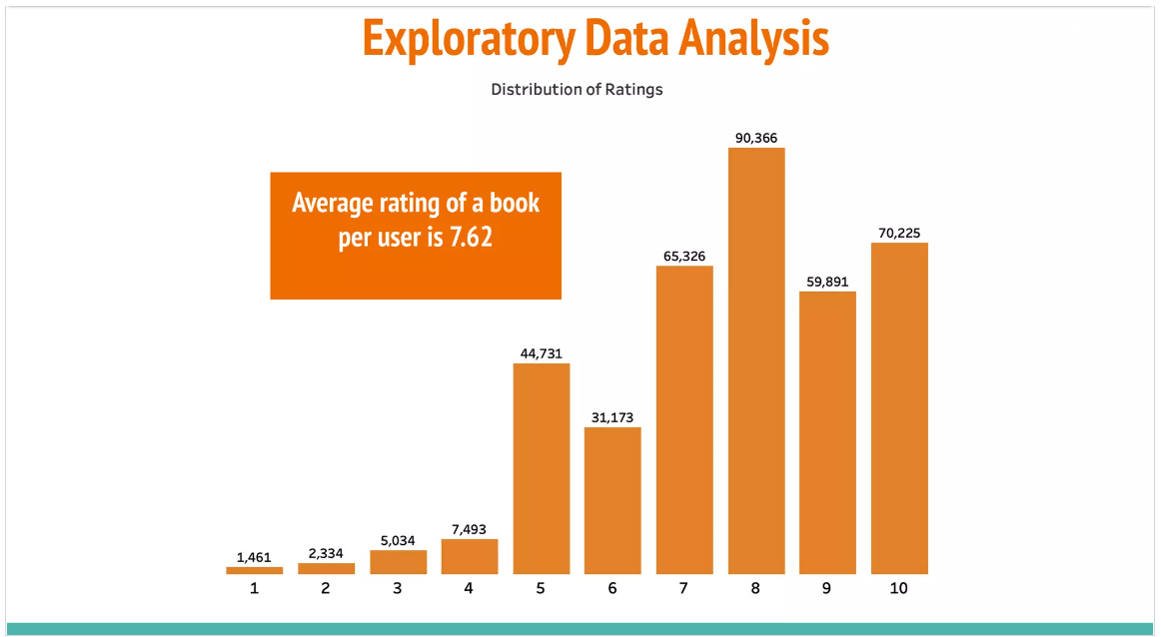

Slide 15
Model Building

Slide 16
Model Building
Collaborative filtering
SVD (Singular Value Decomposition)
User to user collaborative filtering
Item to item collaborative filtering

Slide 17

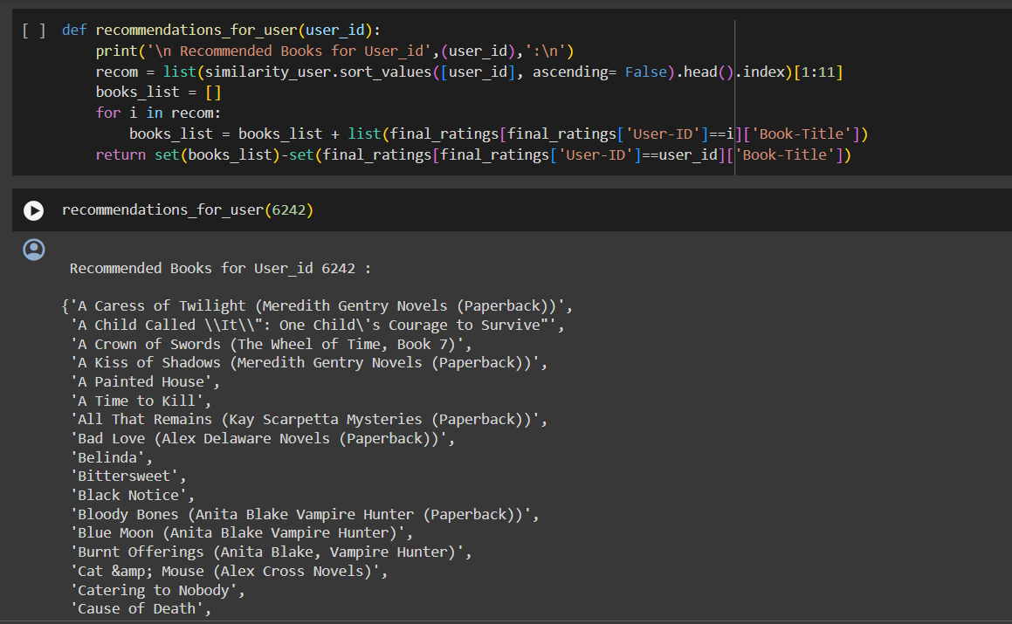
Collaborative filtering
(User to User Collaborative filtering)
1) In User to User collaborative filtering we aims to find similar users
Creating P-dimensional Vector Using Pivot function and then calculated their pairwise distances using cosine metrics
Recommending books to a particular user

Slide 18

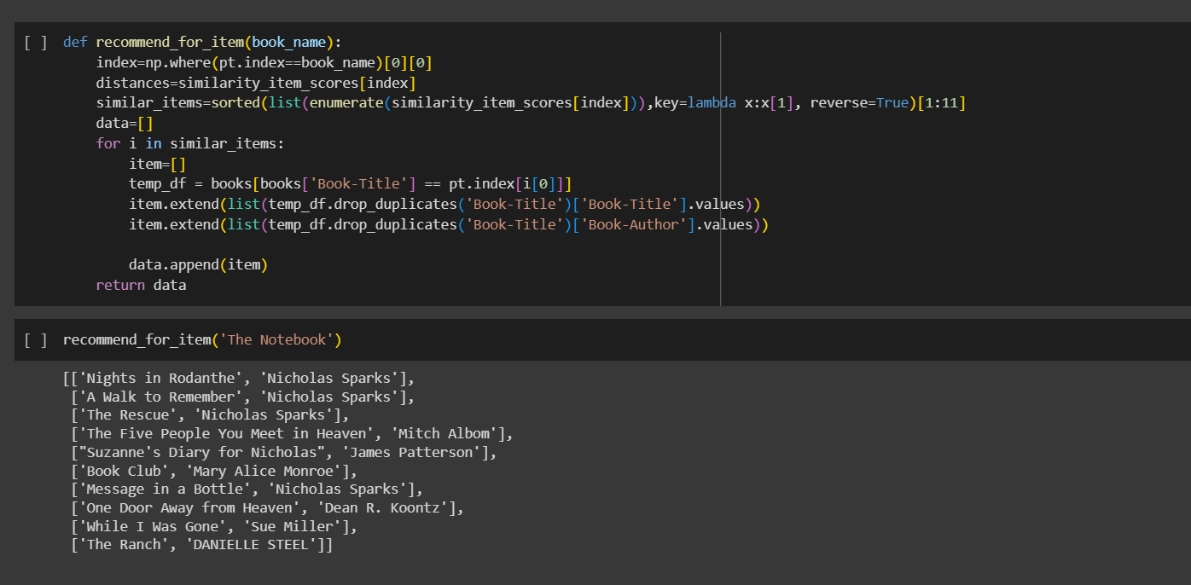
Collaborative filtering
(Item to Item Collaborative filtering)
1) In Item to item collaborative filtering we aims to find similar products
Creating P-dimensional Vector Using Pivot function and then calculated their pairwise distances using cosine metrics
Recommending books to a book title which have similar story line

Slide 19
Model Evaluation & Testing

Slide 20
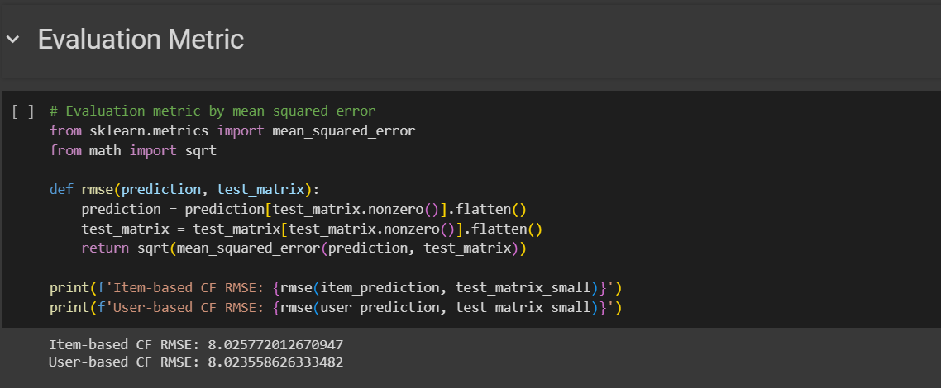
Collaborative filtering Model Evaluation
RMSE (Root Mean Squared Error).
Commonly used measures for evaluating the quality of predictions. It shows how far predictions fall from measured true values using Euclidean distance.
Lower the RMSE value better the model (Near to 0).

Slide 21
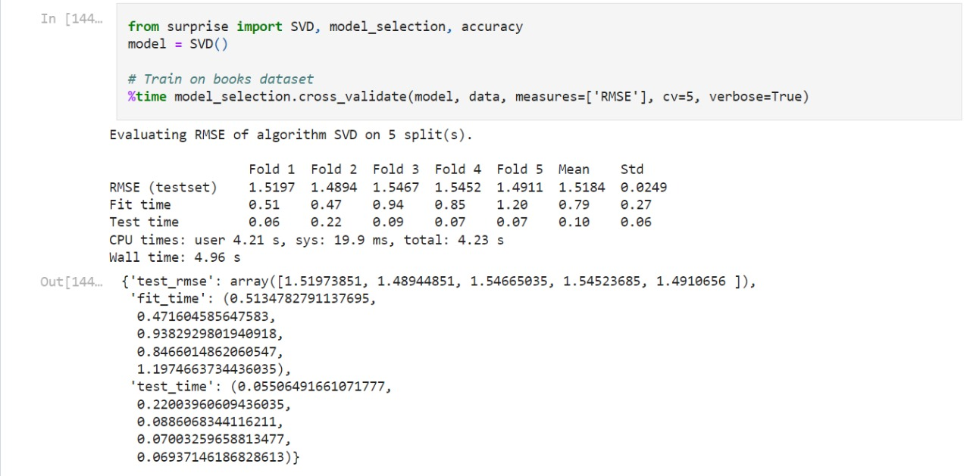
SVD (Singular Value Decomposition)
SVD Singular Value Decomposition
The goal of SVD is to find the optimal set of factors that best predict the outcome.

Slide 22
Model Deployment

Slide 23


Application Used For Deployment
Spyder:Spyder is a free and open-source scientific environment for Python, combining advanced analysis, debugging, editing, and profiling with data exploration.
Streamlit: It is an open-source Python library that makes it easy to create and share custom web apps for machine learning and data science. By using Streamlit you can quickly build and deploy powerful data applications.

Slide 24
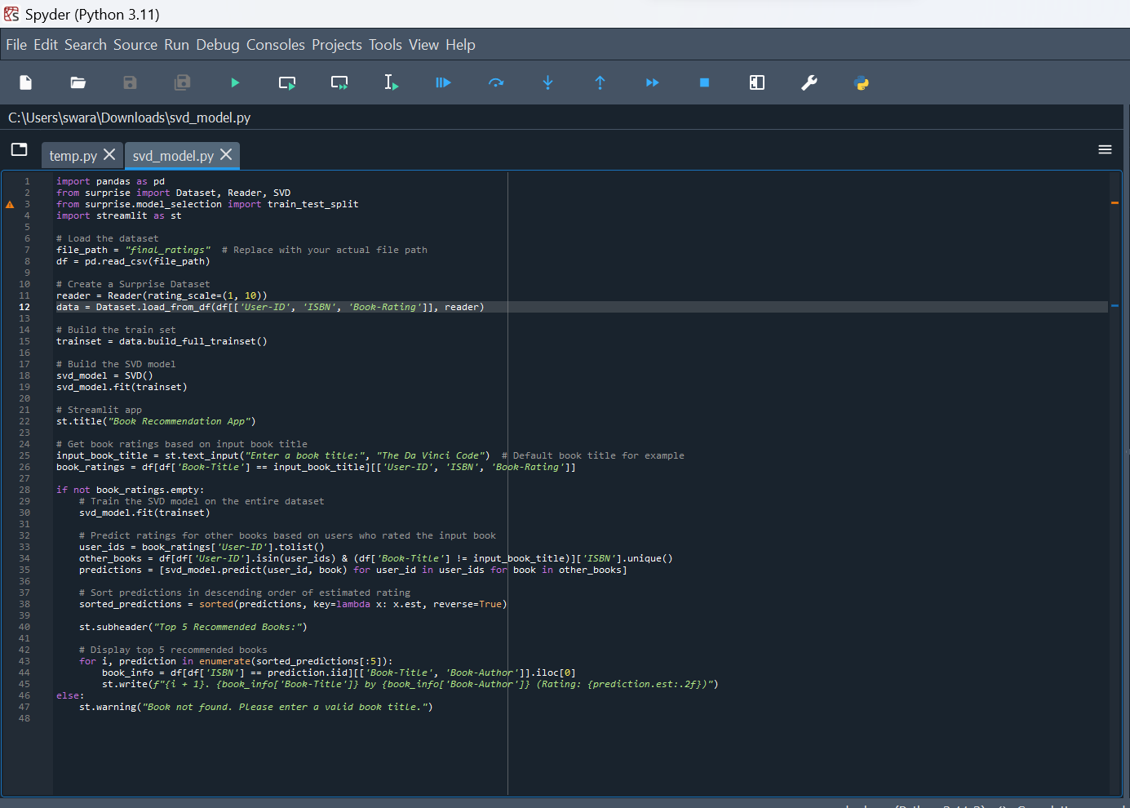
Spyder Code

Slide 25
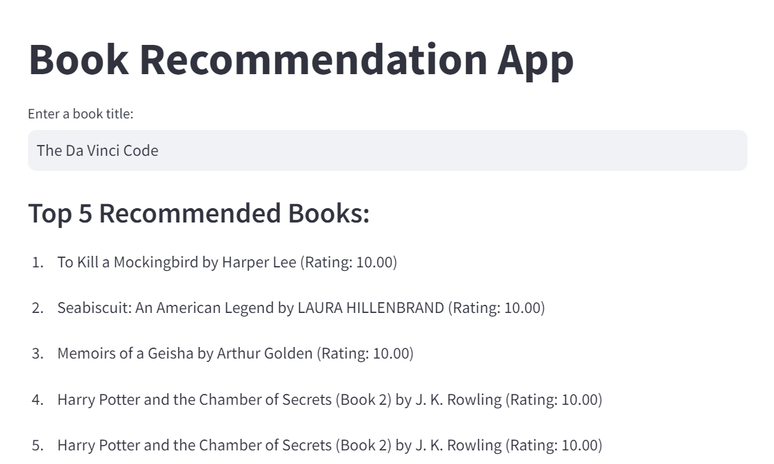
Streamlit WebPortal

Slide 26
Conclusion

Slide 27
Conclusion
Among top 20 Authors the highest number of books has been hold by Agatha Christie. Agatha Christie is leading at top with more than 600 counts, followed by William Shakespeare.
Harlequin has most number of books published, followed by Silhouette.
Number of Books published in yearly are between 1950 - 2005
Most of the users are between 30-40 prefer more books and somewhat we can also view between 20-30
As per ratings "Selected Poems" has been rated most followed by "Little Women"The countplot shows users have rated 0 the most, which means they haven't rated books at all
The top 10 books recommendation as per ratings with top "The lovely BonesA novel" with 707 book ratingsBut this are not based on some recommendation system. They are top 10 books as per ratings.
As we perform by cosine similarity in recommendation system it gives 7.94 RMSE score and SVD improved score it to 1.63 RSME score by Singular Value Decomposition model (SVD).
The evaluation metrics for SVD is best RMSE score for all dataset (i.e users_data, ratings_data and books_data)
As model based approach was best to signify and at last we got top 10 recommended books and ratings respectively

Slide 28
References
Githbut Link-https://github.com/Swarajdeshmukh27/Book-Recommendation
Stramlit App global Link = https://svdmodel.streamlit.app/

Slide 29


